Slide 1














Internship Project Presentation
Presented by Akshat Patil

Slide 2

Declaration
Student name: Akshat Vijay Patil
Internal Guide name: Prof. Ashru Jadhav
External Guide name (Technokraft) :
Roll number: 43.
Branch and Year: TE-AI&DS
College name: K.K. Wagh Institute of Engineering Education and Research
Project title: Predictive Modeling for Loan Approval

Slide 3


Contents
01. Things I Learned
02. Problem Definition
03. EDA and Pre-Processing
04. Model Building
05. Conclusion

Slide 4
Things I Learned
01
02
Descriptive Statistics
Python Libraries
Measures of central tendency:
mean, median, mode
Measures of dispersion:
variance, standard deviation, range
To summarize and describe datasets
NumPy
Pandas
Scikit-learn
Matplotlib
Seaborn

Slide 5
03
04
05
Statistical Analysis
EDA (Exploratory Data Analysis)
Model Building
Independent variable
Dependent variable
Target variable
Univariate Analysis
Bivariate Analysis
Data Cleaning and Preprocessing
Missing value and Outlier detection
Feature Engineering
Evaluation Metrics for Classification
Logistic Regression
Decision Tree Algorithm
Random Forest Algorithm

Slide 6
Problem Definition
Title: Predictive Modeling for Loan Approval
Problem Statement:
The Dream Housing Finance company aims to automate the loan eligibility process for customers applying for home loans online. They want to identify eligible customer segments based on details provided in the application form such as gender, marital status, education, income, credit history, etc. This automation will help them target specific customer segments for loan approval.
Objective:
It is a classification problem where we have to predict whether a loan would be approved or not. In this problem, we have to predict discrete values based on a given set of independent variables (s).

Slide 7
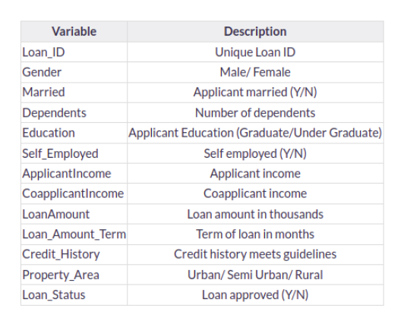
Dataset:
The loan prediction dataset is structured as a CSV file and consists of several columns representing various attributes related to loan applications. Each row in the dataset corresponds to a single loan application, with each column providing specific details about that application. The goal is to predict whether a loan application will be approved or denied based on the provided attributes.

Slide 8
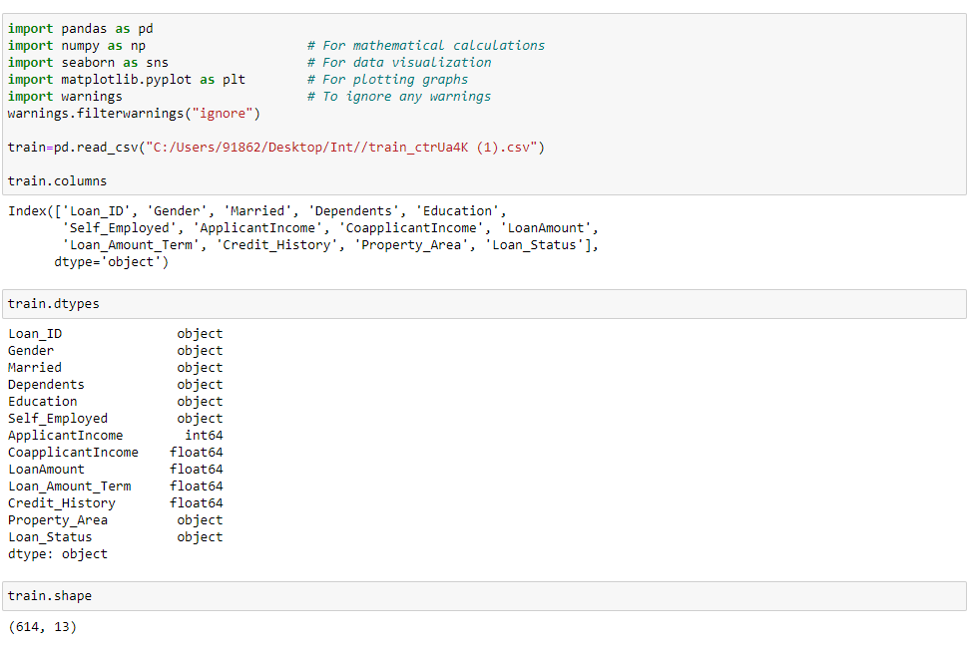
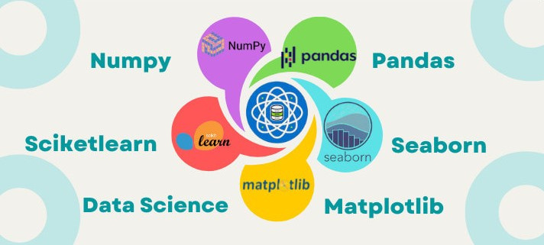
EDA and Pre-Processing
Importing Python Libraries and Reading a CSV file into a DataFrame, then displaying the column names, data types, and shape of the DataFrame.

Slide 9
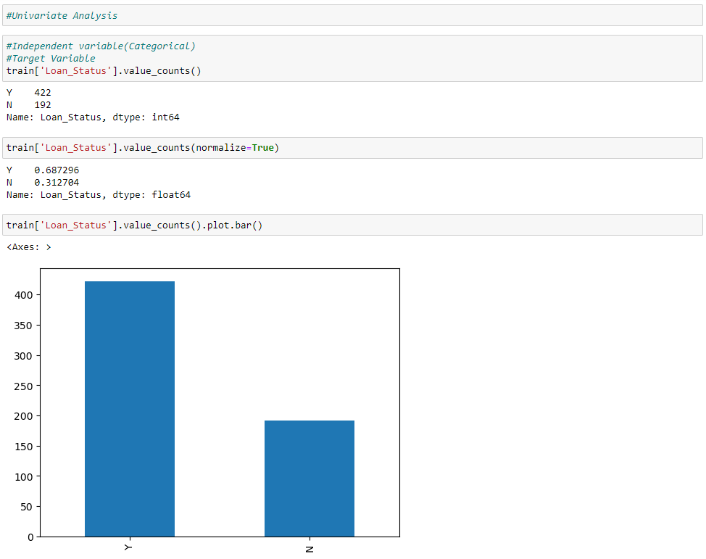
Univariate Analysis
Analyzing data where we analyze each variable individually. For categorical features, we will use bar plots to calculate the number of each category in a particular variable.
Target variable, i.e., Loan_Status. As it is a categorical variable, let us look at its frequency table, percentage distribution, and bar plot
422(around 69%) people out of 614 got the approval.

Slide 10
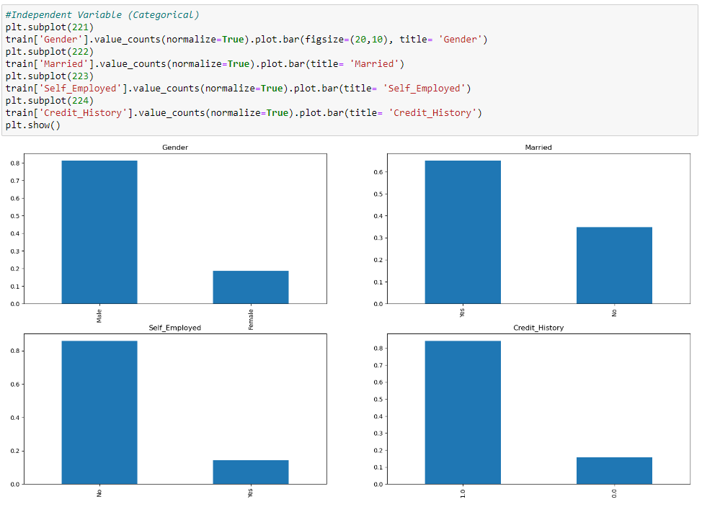
Categorical features: These features have categories (Gender, Married, Self_Employed, Credit_History)
80% of applicants in the dataset are male.
Around 65% of the applicants in the dataset are married.
About 15% of applicants in the dataset are self-employed.
About 85% of applicants have repaid their debts.

Slide 11
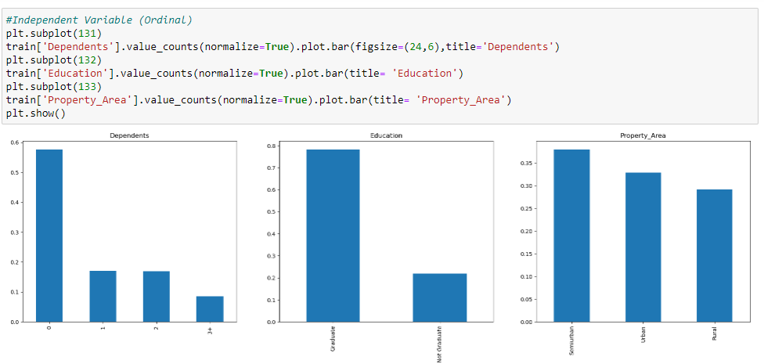
Ordinal features: Variables in categorical features having some order involved (Dependents, Education, Property_Area)
Most of the applicants don’t have dependents.
About 80% of the applicants are graduates.
Most of the applicants are from semi-urban areas.

Slide 12
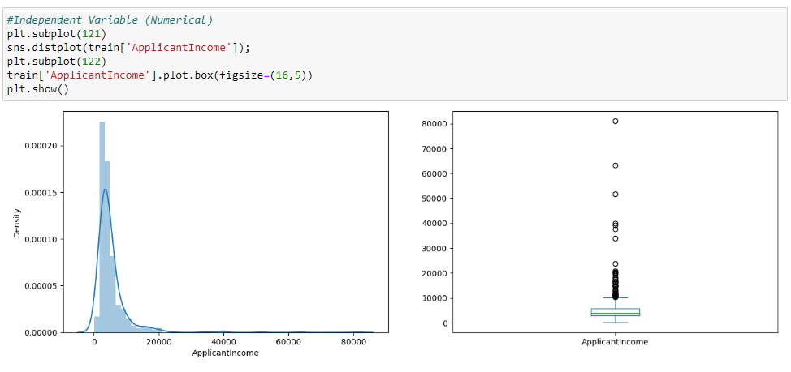
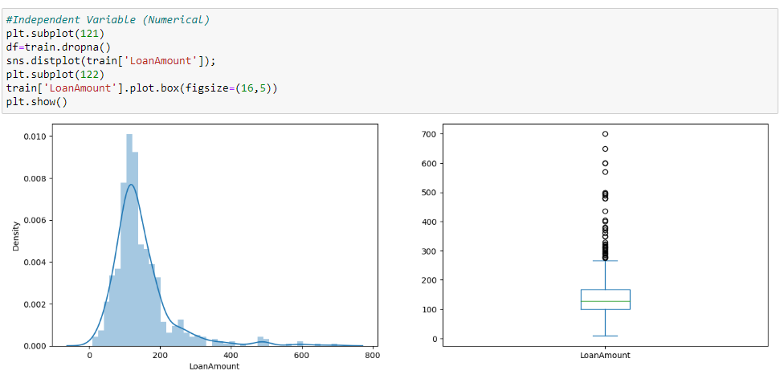
Numerical features: These features have numerical values (ApplicantIncome, CoapplicantIncome, LoanAmount, Loan_Amount_Term)
It can be inferred that most of the data in the distribution of applicant income are towards the left which means it is not normally distributed.
It can be inferred that there are lot of outliers in the LoanAmount variable and the distribution is fairly normal.

Slide 13
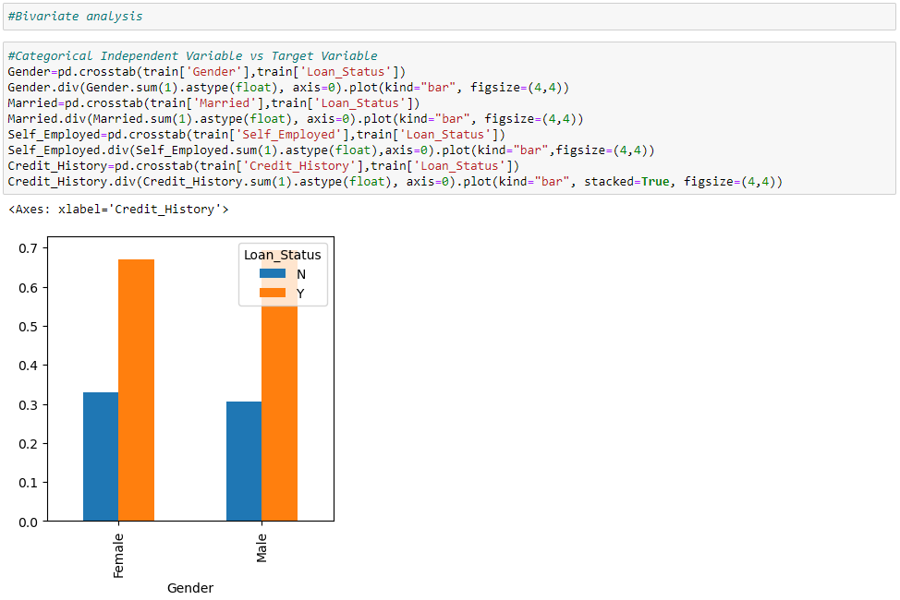
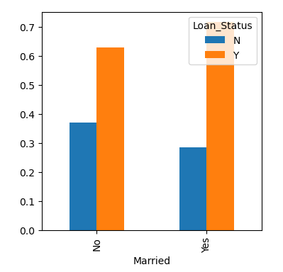
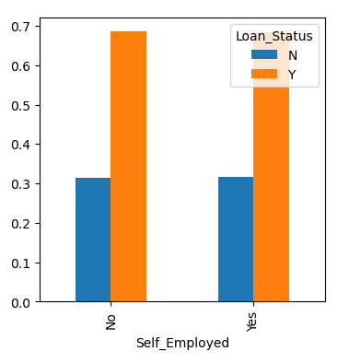
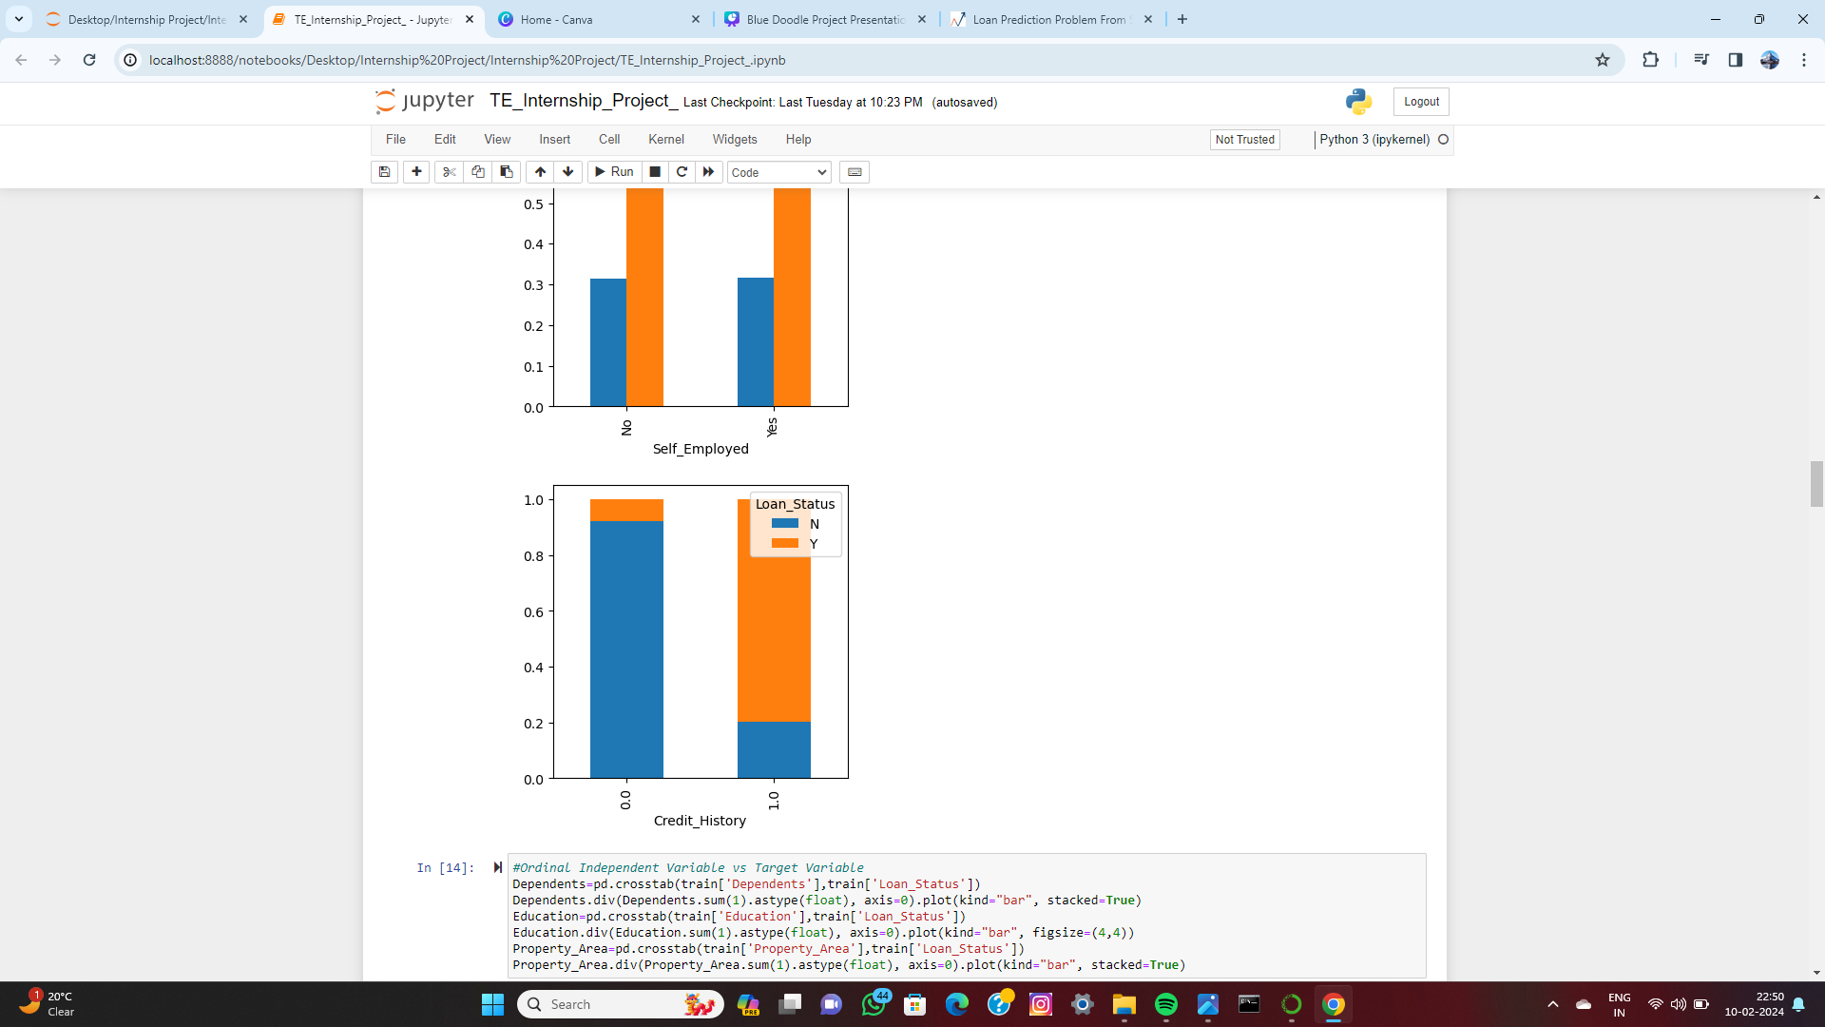
Bivariate Analysis
Assesses the relationship between two variables: for categorical and ordinal independent variables versus the target variable, it evaluates how each category or order influences the target, while for numerical independent variables versus the target variable, it examines how numerical values impact the target.
Categorical Independent Variable vs Target Variable

Slide 14
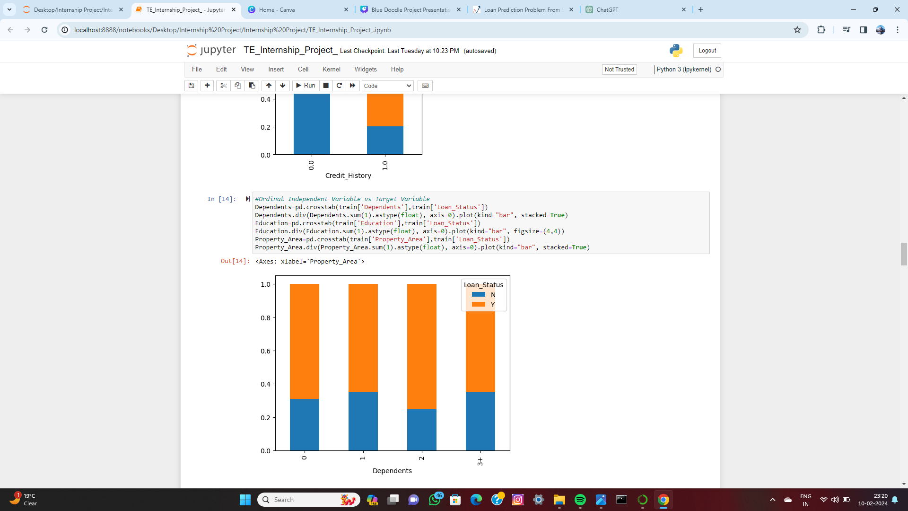
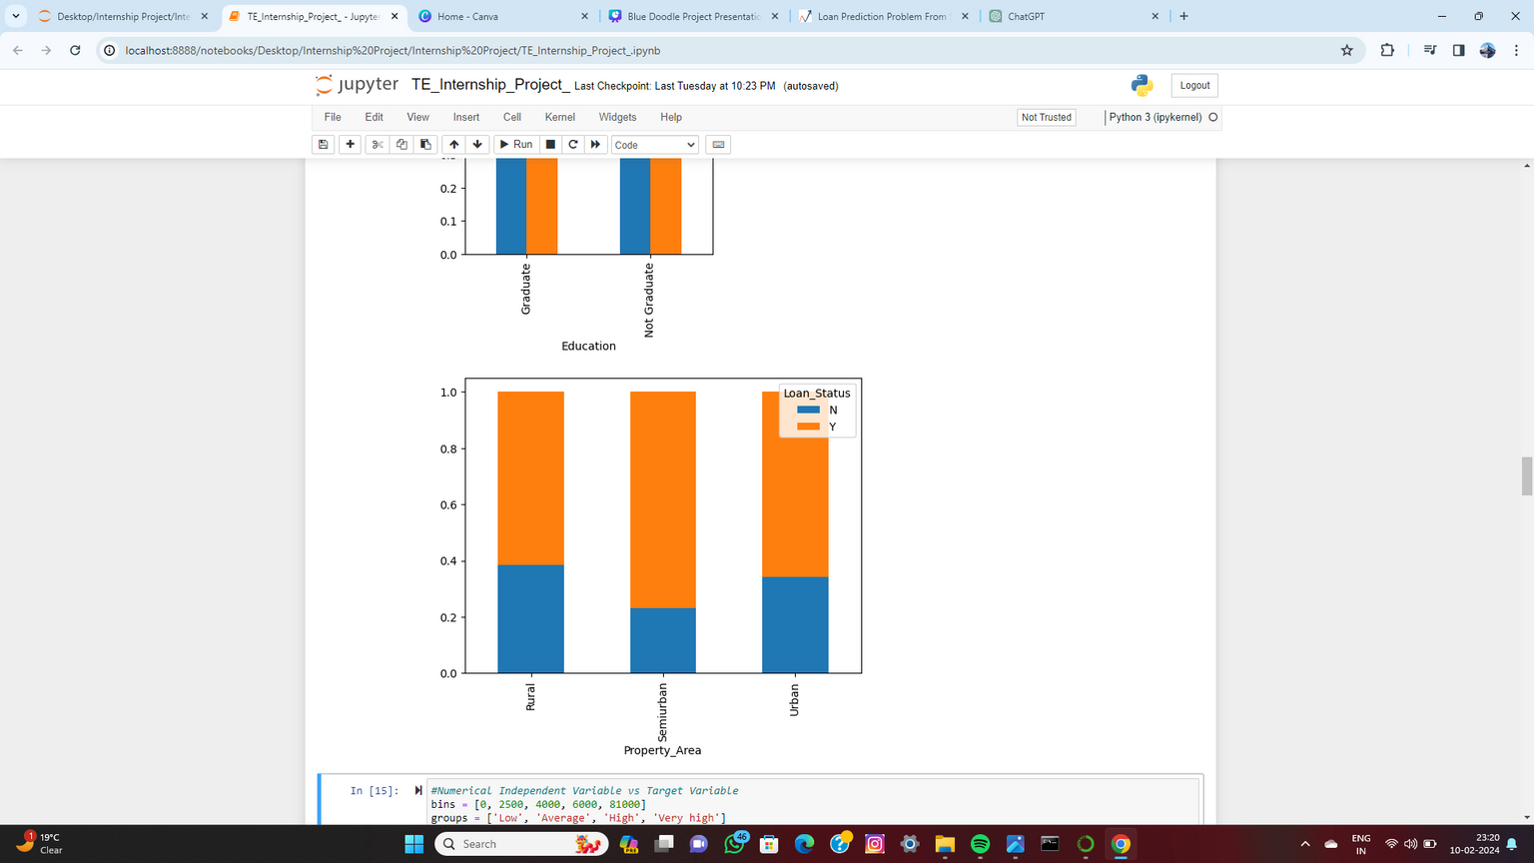
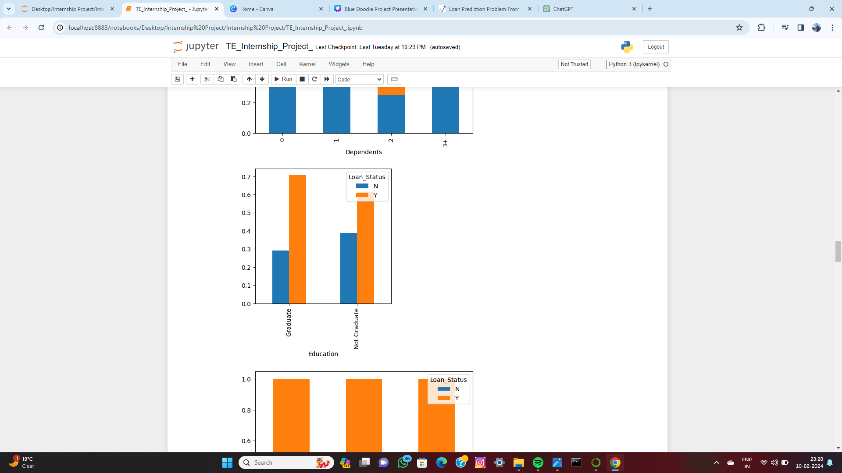
Ordinal Independent Variable vs Target Variable
The distribution of applicants with 1 or 3+ dependents is similar across both the categories of Loan_Status.
The distribution of applicants living in urban and rural area is similar across both the categories of Loan_Status and a slightly less for semi-urban.
The distribution of applicants whose Loan_Status is approved is more for graduated and is less than Not graduated for not approved.

Slide 15
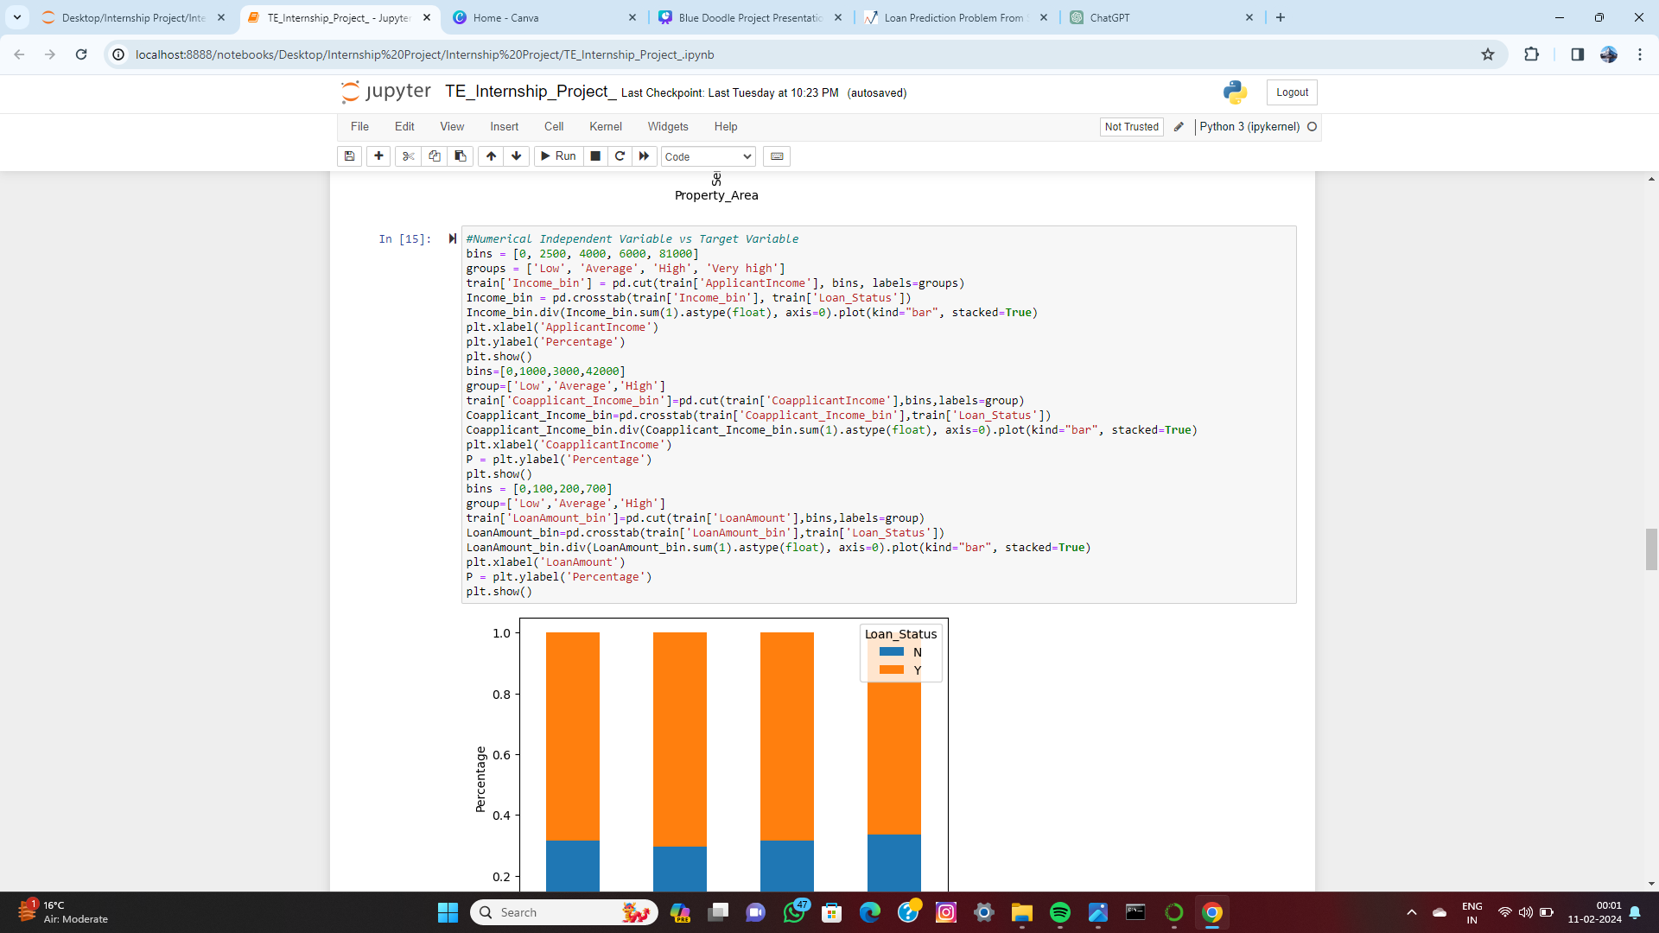
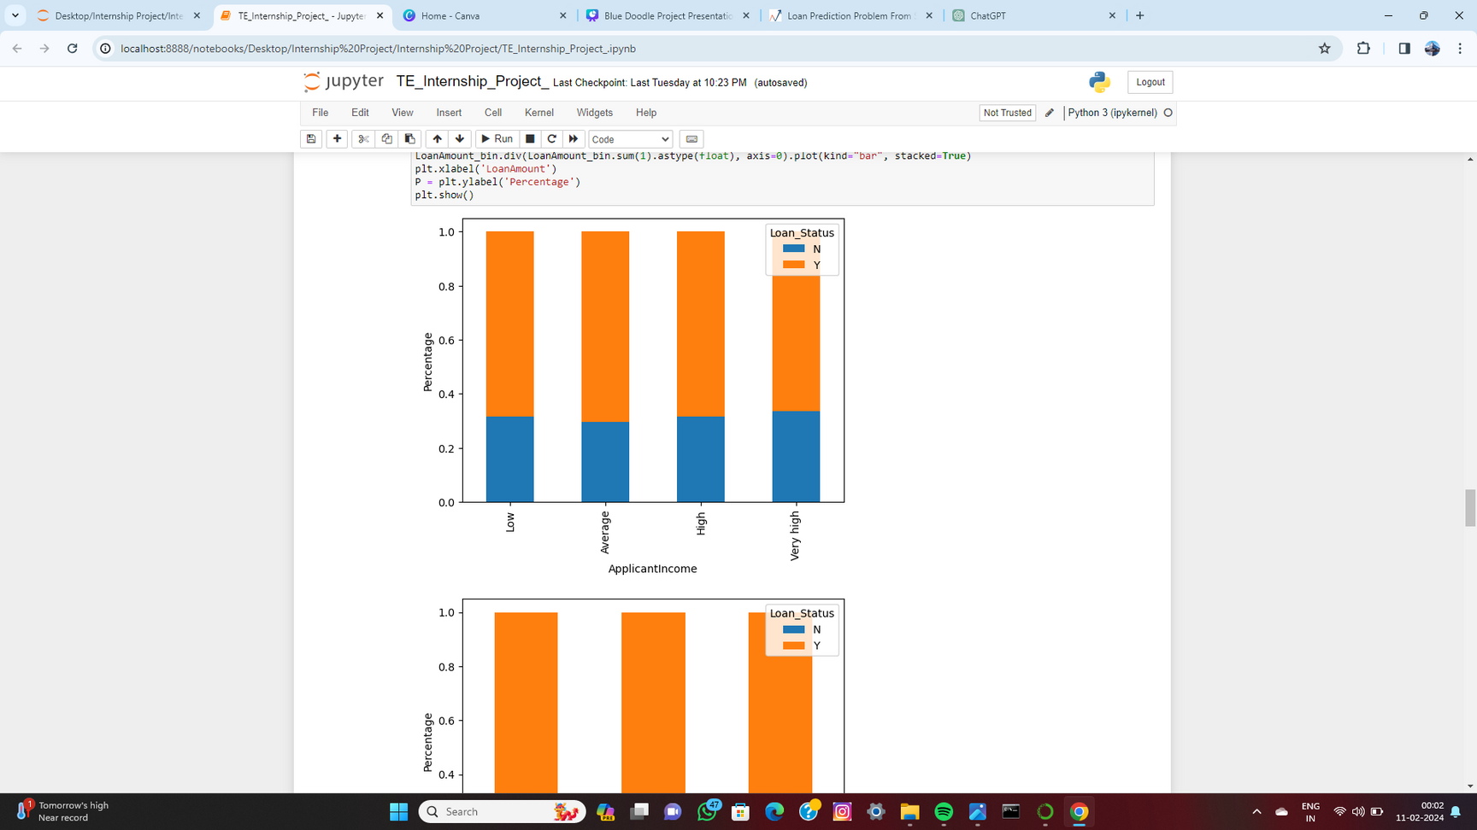
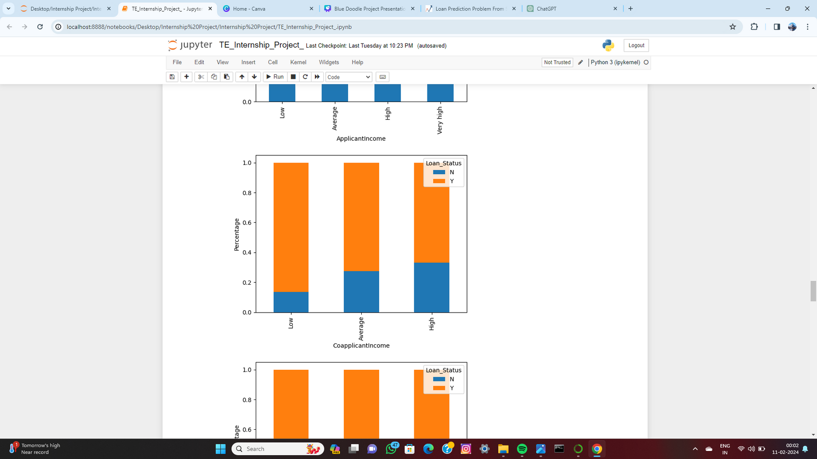
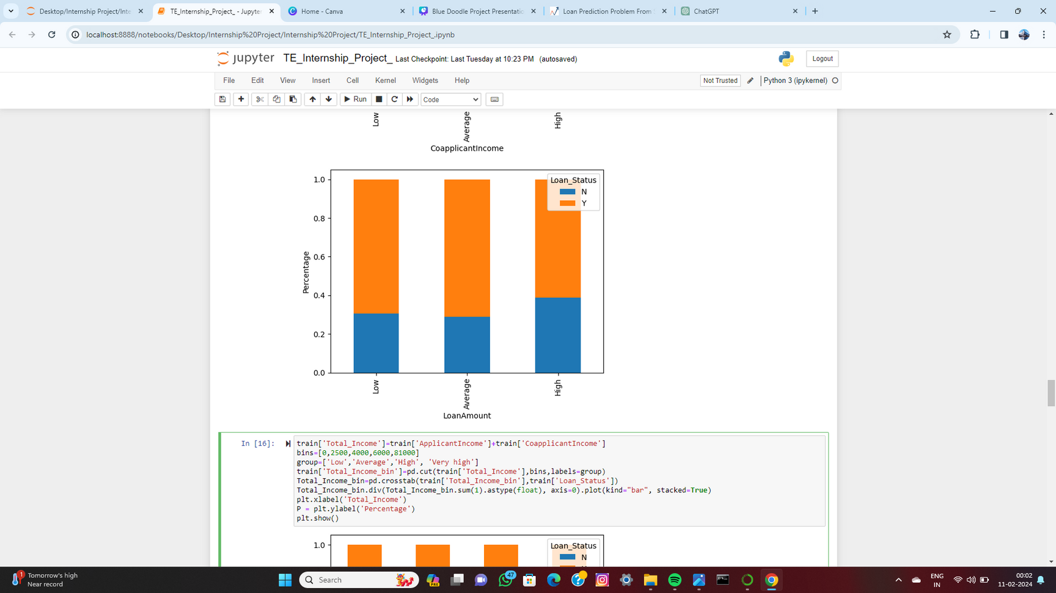
Numerical Independent Variable vs Target Variable
It shows that if co-applicants income is less the chances of loan approval are high.
The proportion of approved loans is higher for Low and Average Loan Amounts as compared to that of High Loan Amounts.

Slide 16
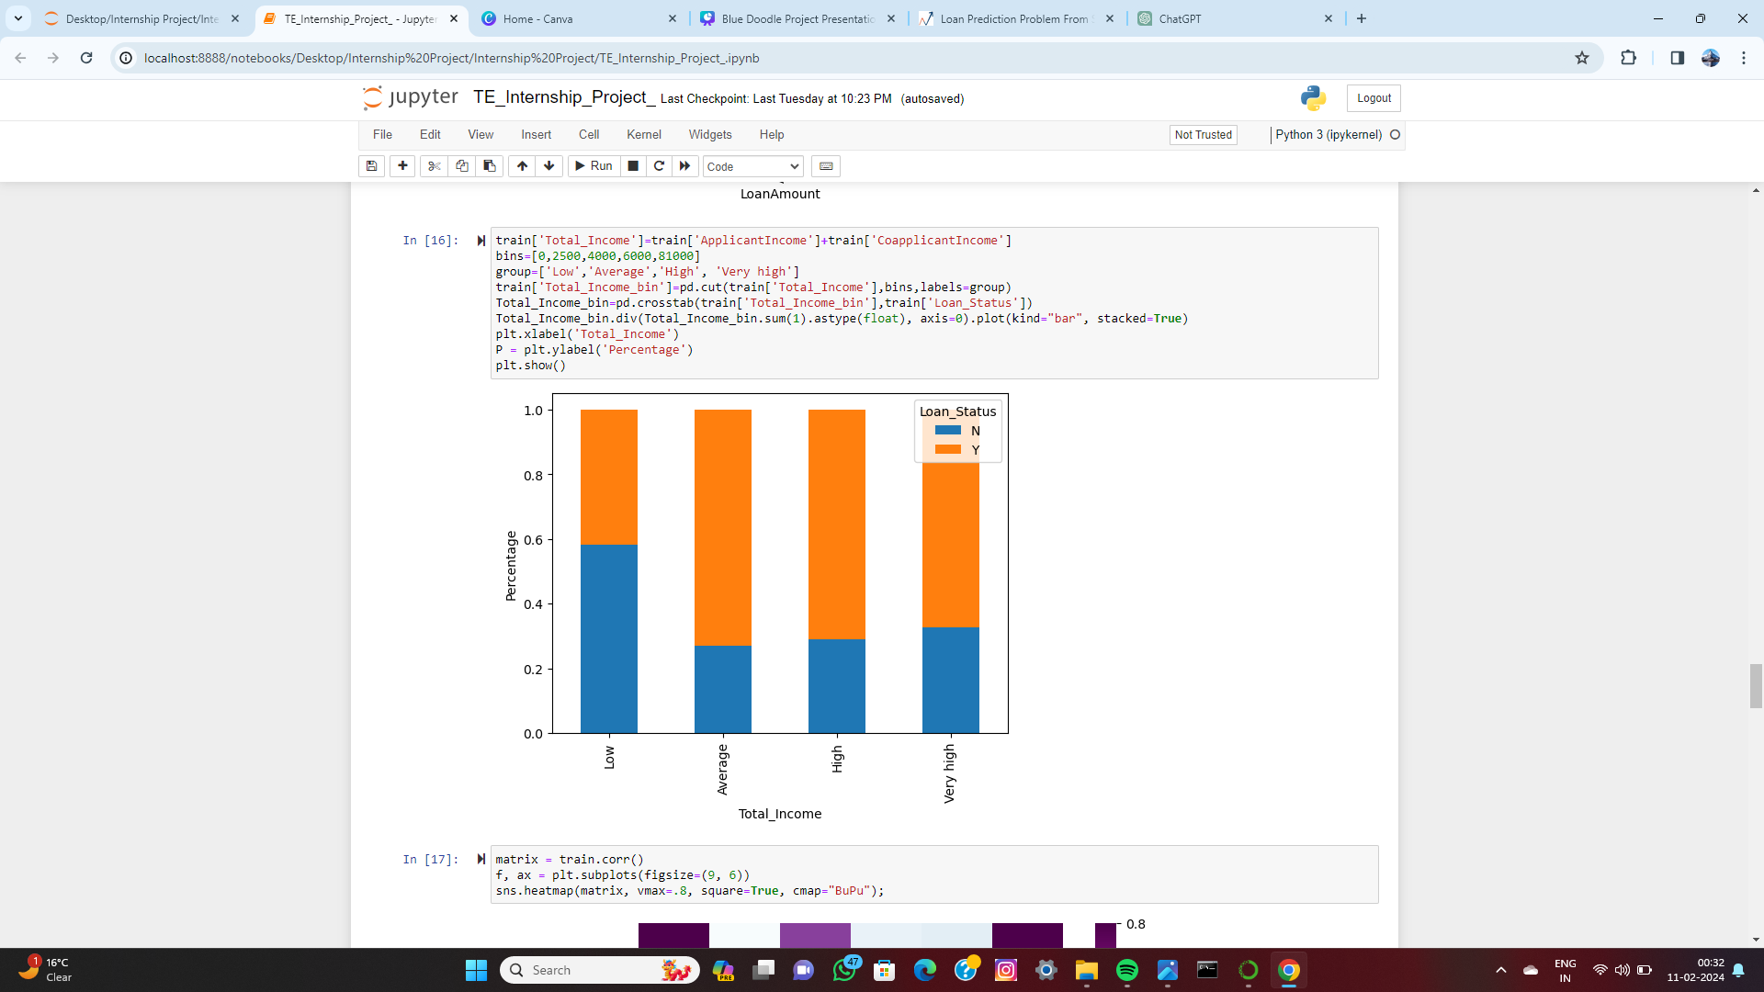
Feature engineering
It shows that if co-applicants income is less the chances of loan approval are high. But this does not look right. The possible reason behind this may be that most of the applicants don’t have any co-applicant so the co-applicant income for such applicants is 0 and hence the loan approval is not dependent on it. So we can make a new variable in which we will combine the applicant’s and co applicants’ income to visualize the combined effect of income on loan approval.
Proportion of loans getting approved for applicants having low Total_Income is very less as compared to that of applicants with Average, High, and Very High Income.

Slide 17
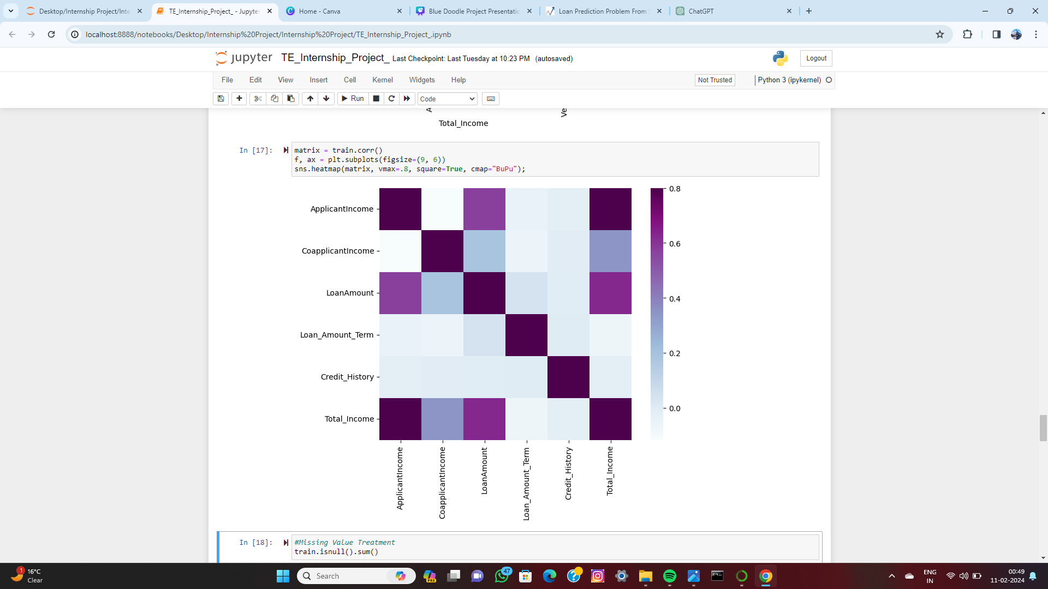
Correlation between all the numerical variables using the heat map.
The variables with darker colors mean their correlation is more.

Slide 18
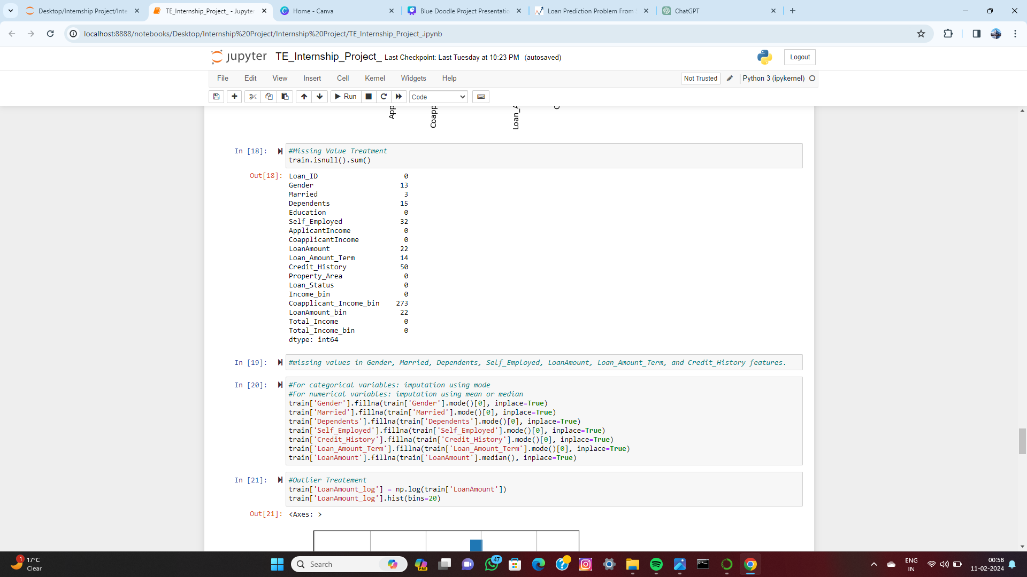
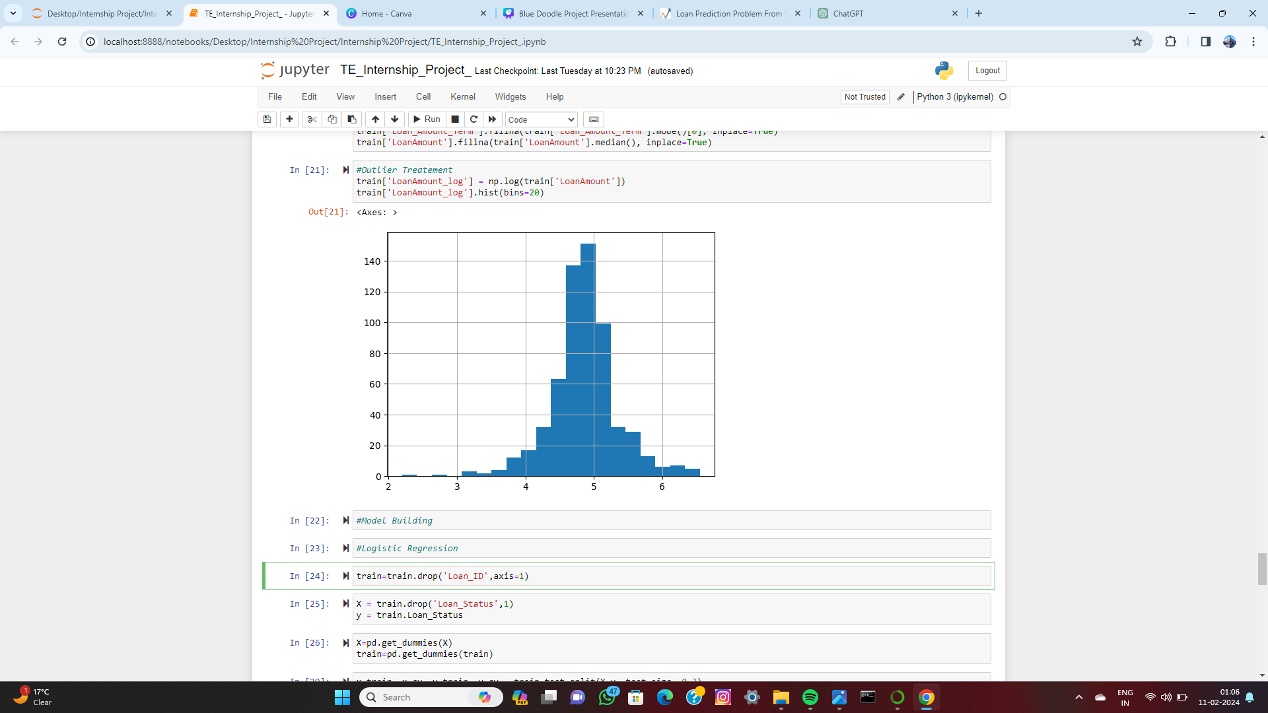
Missing Value and Outlier Treatment
For numerical variables: imputation using mean or median.
For categorical variables: imputation using mode
Doing the log transformation To remove the right skewness. As we take the log transformation, it does not affect the smaller values much but reduces the larger values. So, we get a distribution similar to the normal distribution.

Slide 19
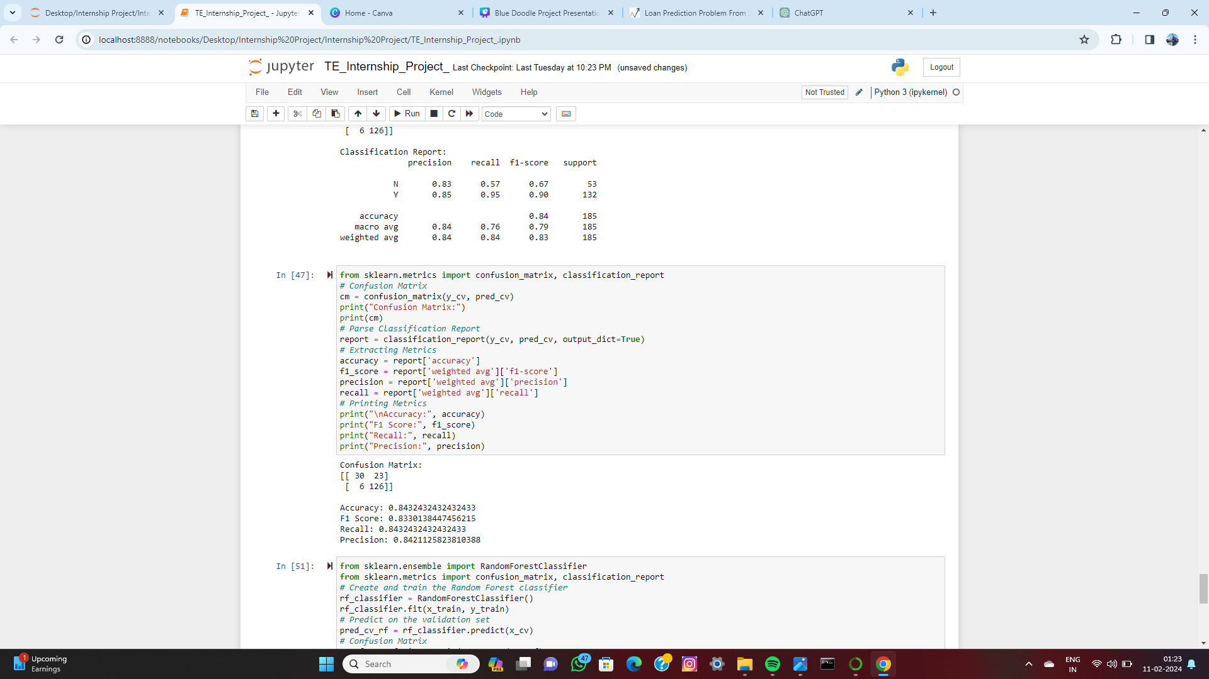
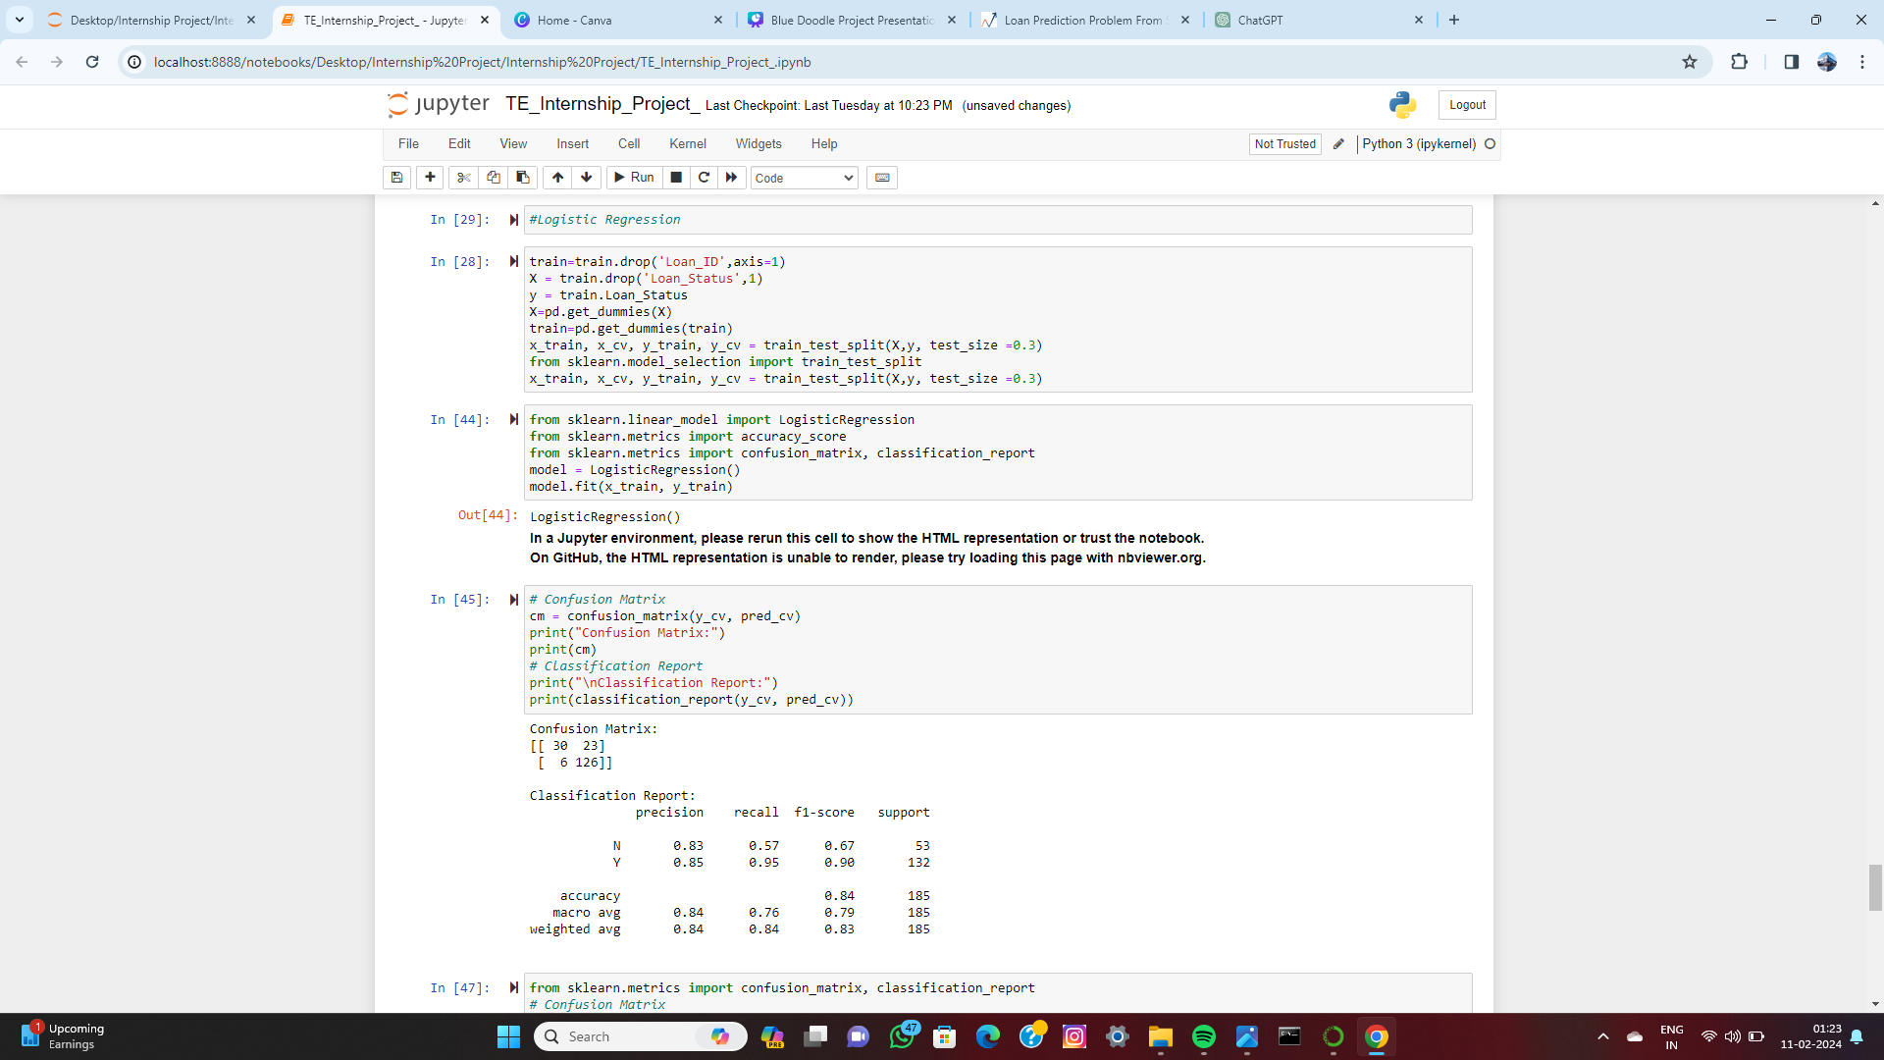
Model Building
Logistic Regression
Result

Slide 20
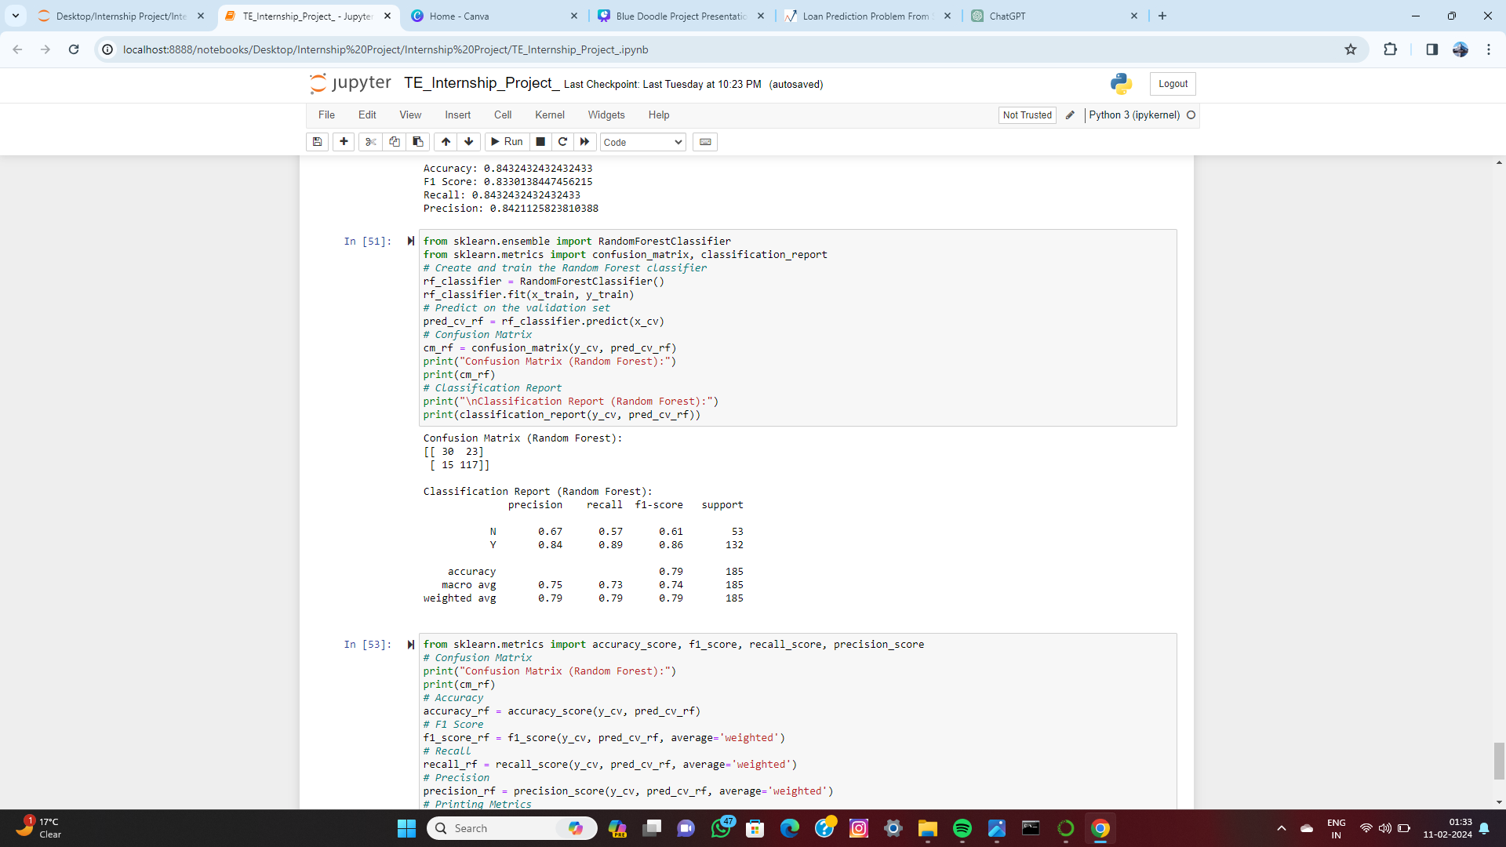
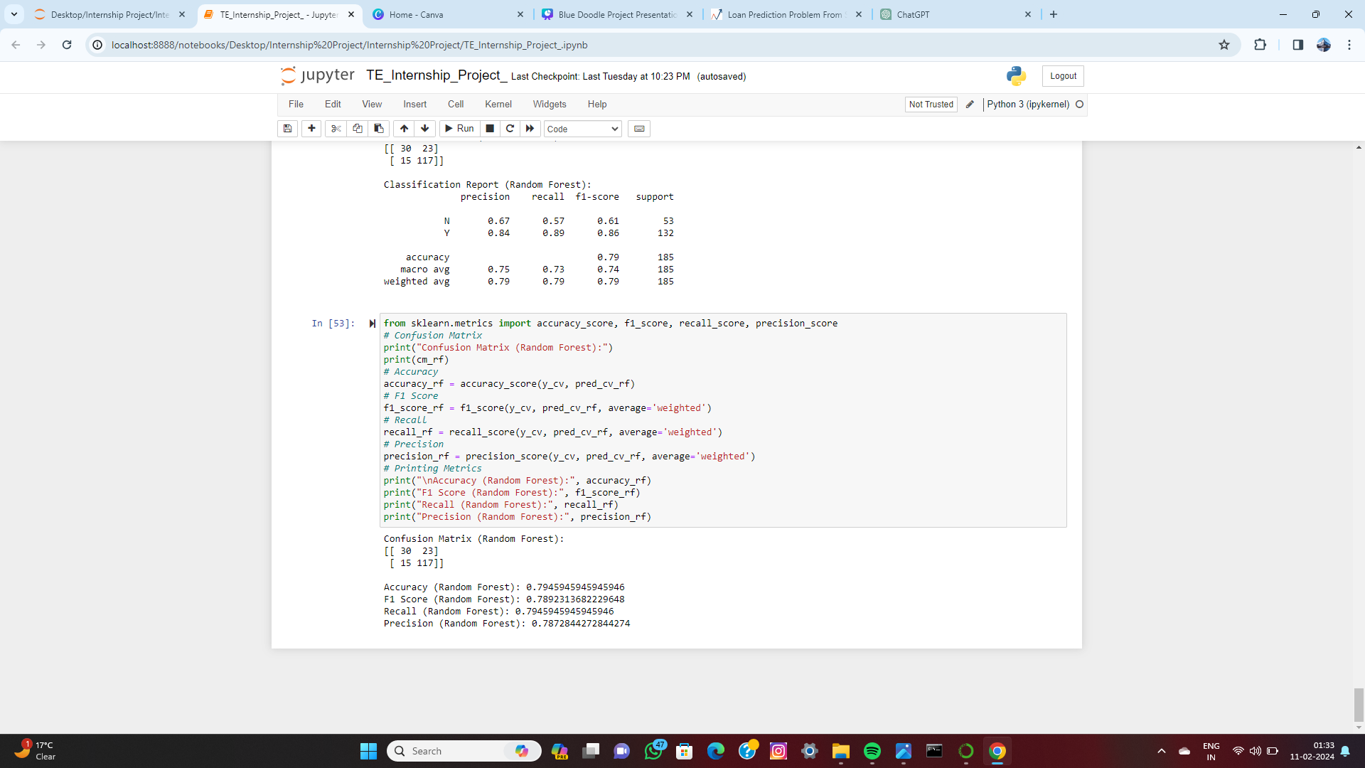
Random Forest
Result

Slide 21
Conclusion
In conclusion, the loan prediction project showcased the power of data science in extracting actionable insights from complex datasets. By leveraging techniques like exploratory data analysis, feature engineering, and model evaluation, data scientists can uncover patterns, make accurate predictions, and drive informed decision-making. This project underscores the role of data science in tackling real-world challenges and highlights its potential to revolutionize industries through data-driven solutions.

Slide 22
Thank you!!

